Slide 1
Segmentation by clustering

Slide 2
K-Means Algorithm
K-means clustering algorithm computes the centroids
It iterates until optimal centroid is found.
Assumption: No. of Clusters are already known.
It is also called flat clustering algorithm.
The number of clusters identified from data is represented by ‘K’ in K-means.
In this algorithm, the data points are assigned to a cluster in such a manner that the sum of the squared distance between the data points and centroid would be minimum.

Slide 3
Step 1 − First, we need to specify the number of clusters, K, need to be generated by this algorithm.
Step 2 − Next, randomly select K data points and assign each data point to a cluster. In simple words, classify the data based on the number of data points.
Step 3 − Now it will compute the cluster centroids.

Slide 4
Step 4 − Next, keep iterating the following until we find optimal centroid which is the assignment of data points to the clusters that are not changing any more
4.1 − First, the sum of squared distance between data points and centroids would be computed.
4.2 − Now, we have to assign each data point to the cluster that is closer than other cluster (centroid).
4.3 − At last compute the centroids for the clusters by taking the average of all data points of that cluster.

Slide 5
K-means follows Expectation-Maximization approach to solve the problem.
The Expectation-step is used for assigning the data points to the closest cluster and the Maximization-step is used for computing the centroid of each cluster.

Slide 6
Advantages
The following are some advantages of K-Means clustering algorithms −
It is very easy to understand and implement.
If we have large number of variables then, K-means would be faster than Hierarchical clustering.
On re-computation of centroids, an instance can change the cluster.
Tighter clusters are formed with K-means as compared to Hierarchical clustering.

Slide 7
Disadvantages
The following are some disadvantages of K-Means clustering algorithms −
It is a bit difficult to predict the number of clusters i.e. the value of k.
Output is strongly impacted by initial inputs like number of clusters (value of k)
Order of data will have strong impact on the final output.
It is very sensitive to rescaling. If we will rescale our data by means of normalization or standardization, then the output will completely change.
It is not good in doing clustering job if the clusters have a complicated geometric shape.

Slide 8
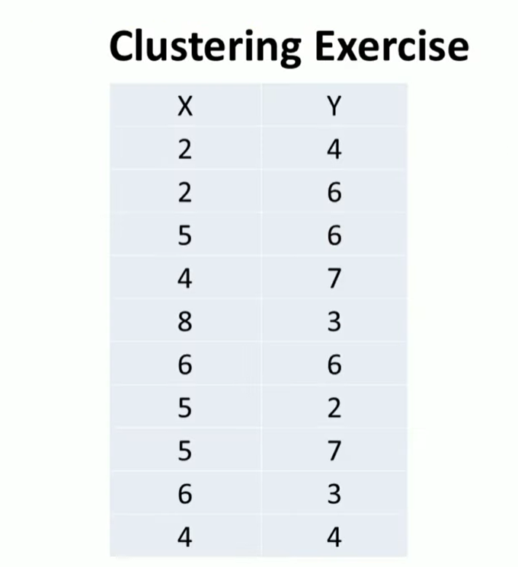

Slide 9
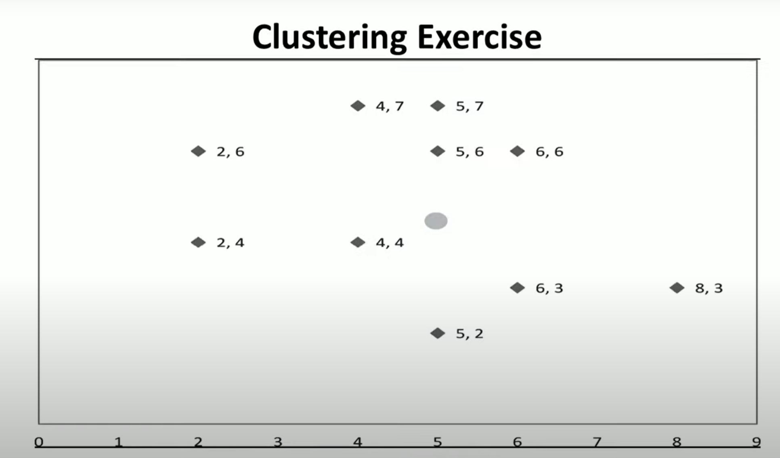

Slide 10
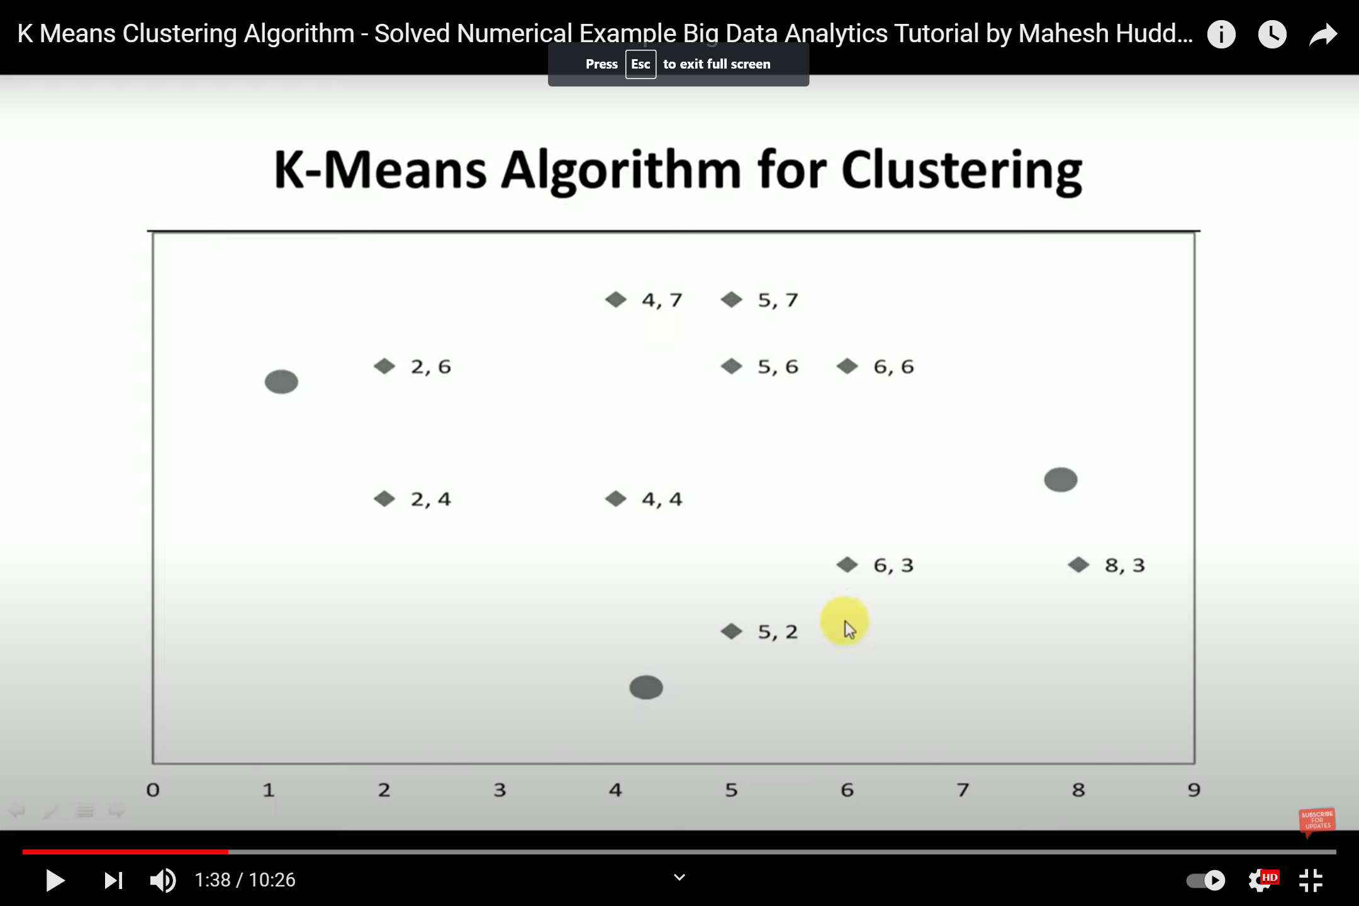

Slide 11
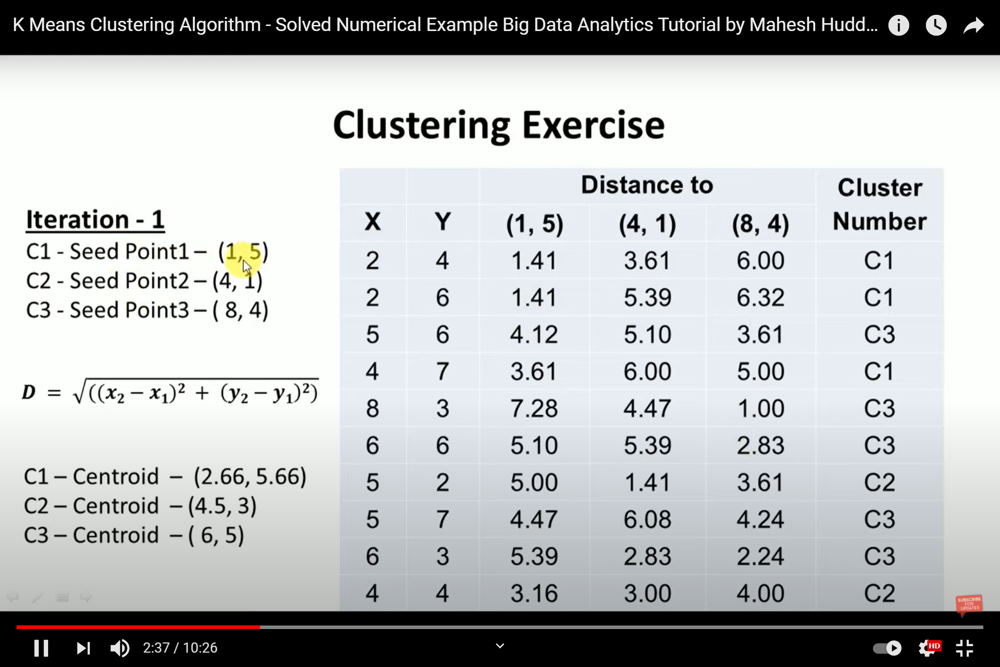

Slide 12
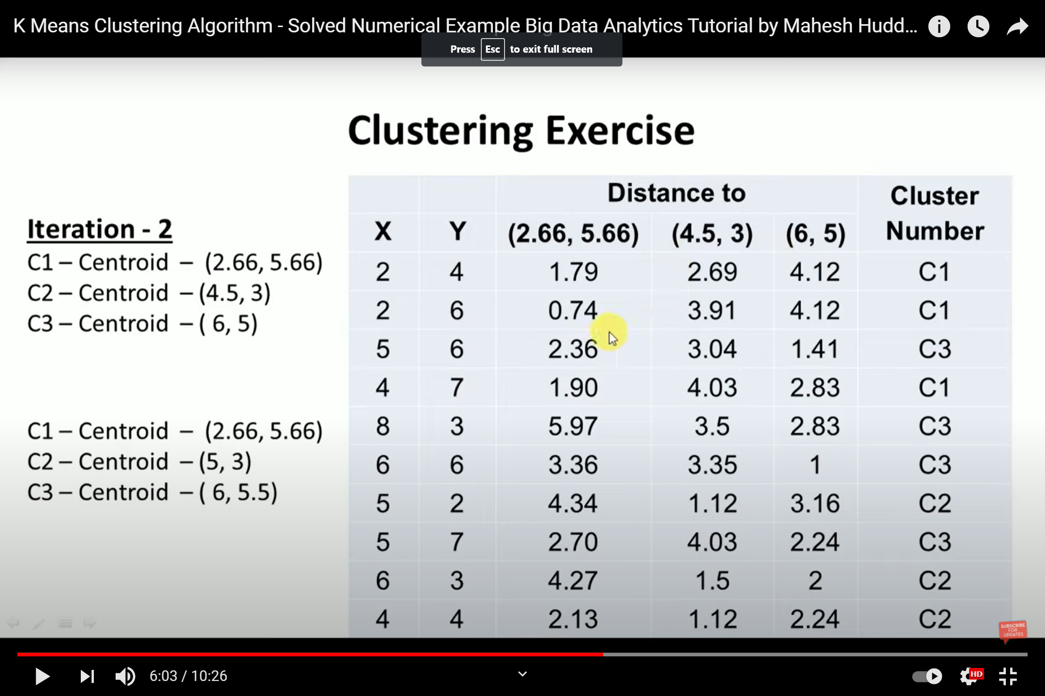

Slide 13
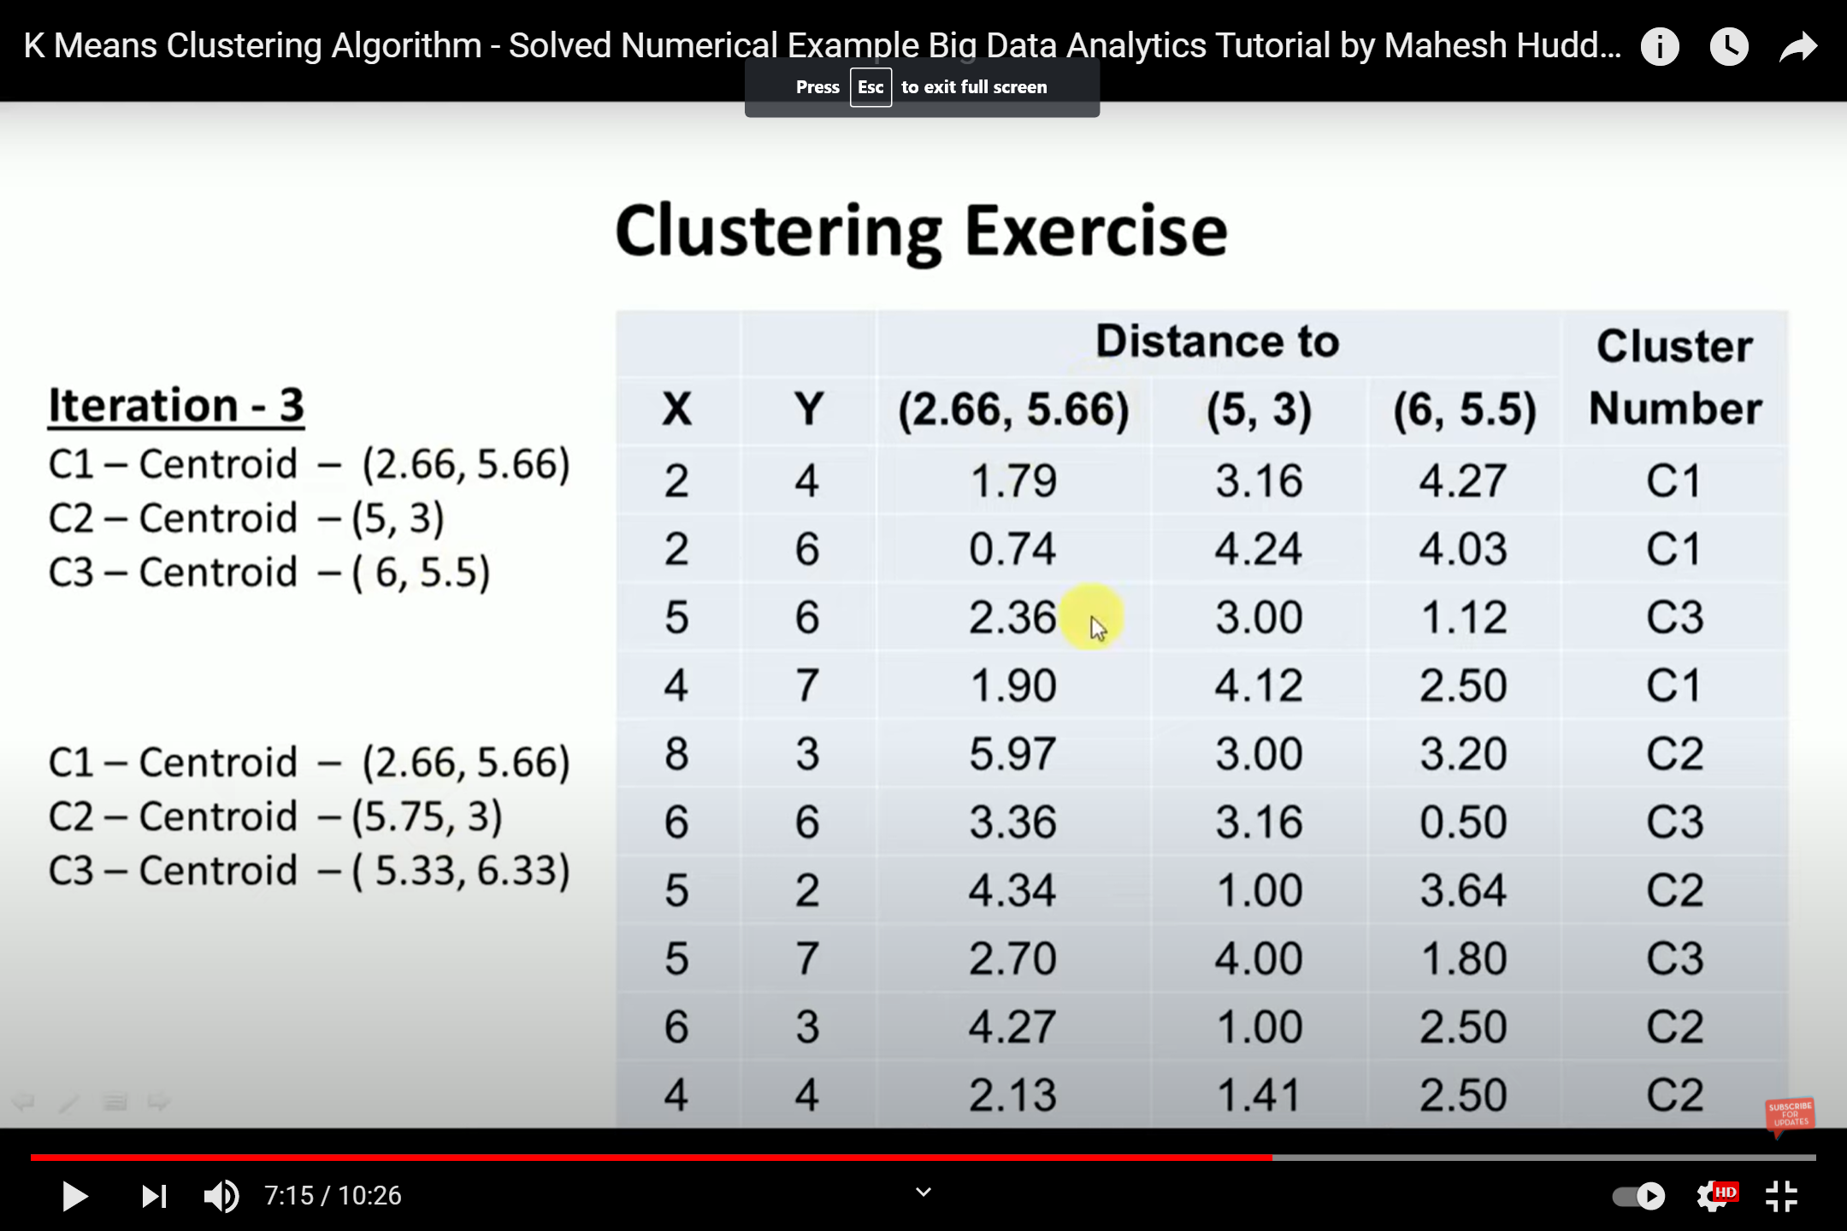

Slide 14
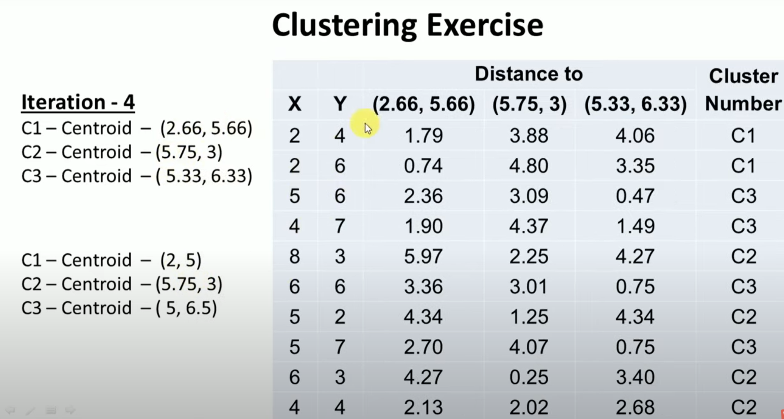

Slide 15
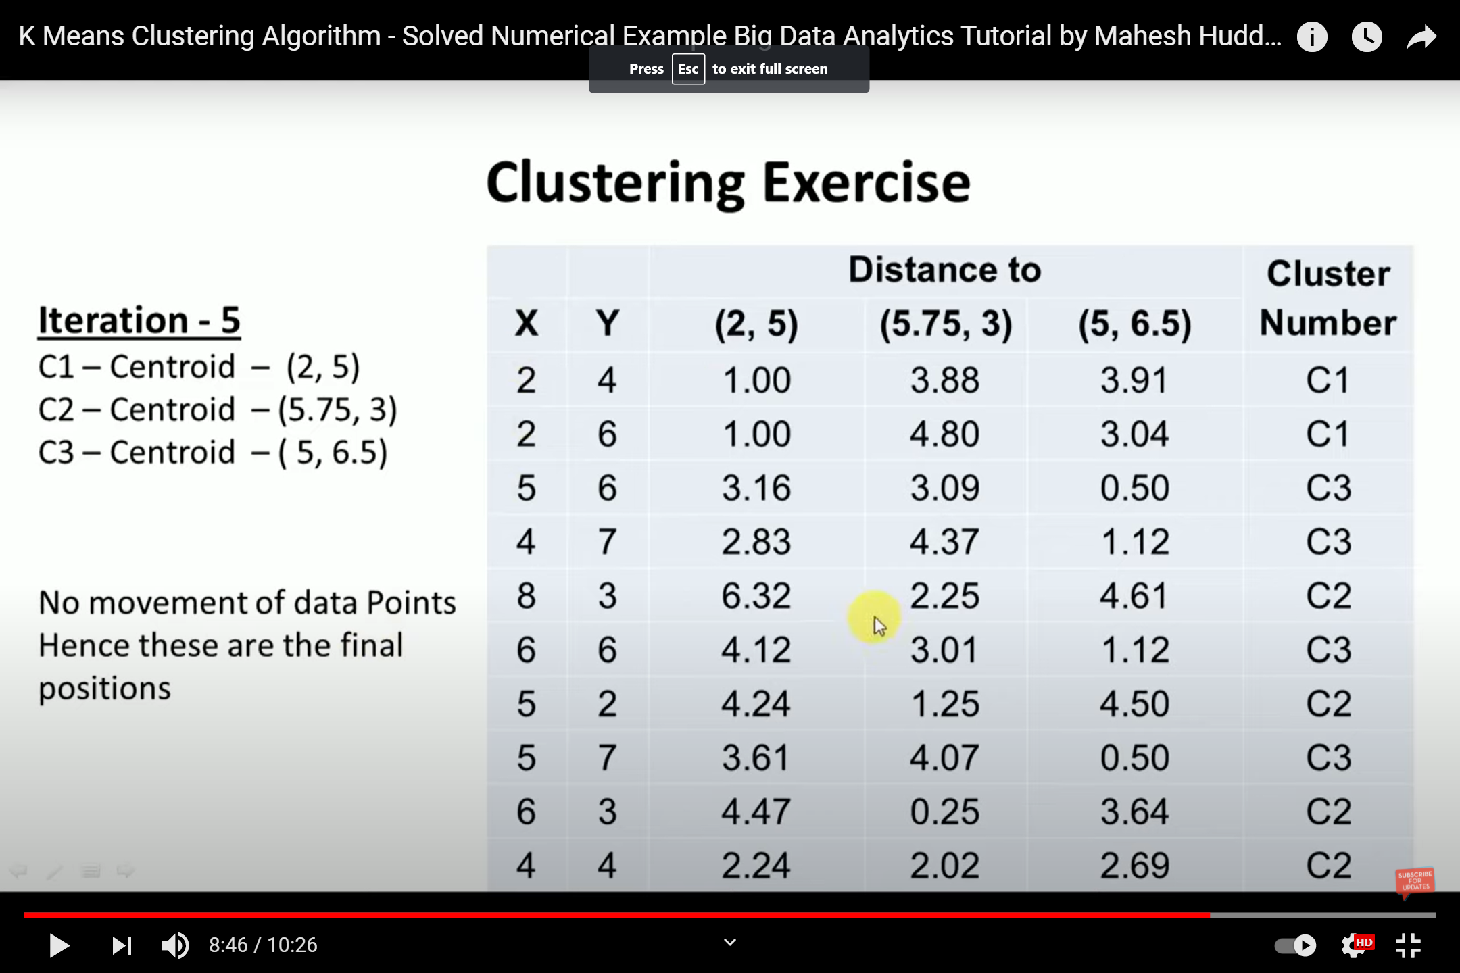

Slide 16
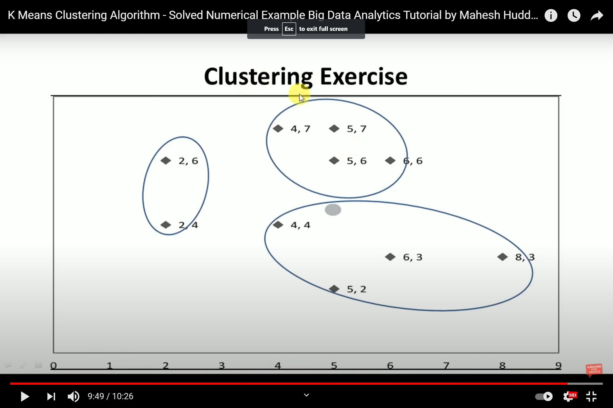

Slide 17
k-medoids Clustering
k-medoids is another type of clustering algorithm that can be used to find natural groupings in a dataset.
k-medoids clustering is very similar to k-means clustering, except for a few differences.
The k-medoids clustering algorithm has a slightly different optimization function than k-means.
k-medoids clustering gives almost identical results to k-means clustering. But in some special cases where we have outliers in a dataset, k-medoids clustering is preferred as it's more robust to outliers.

Slide 18
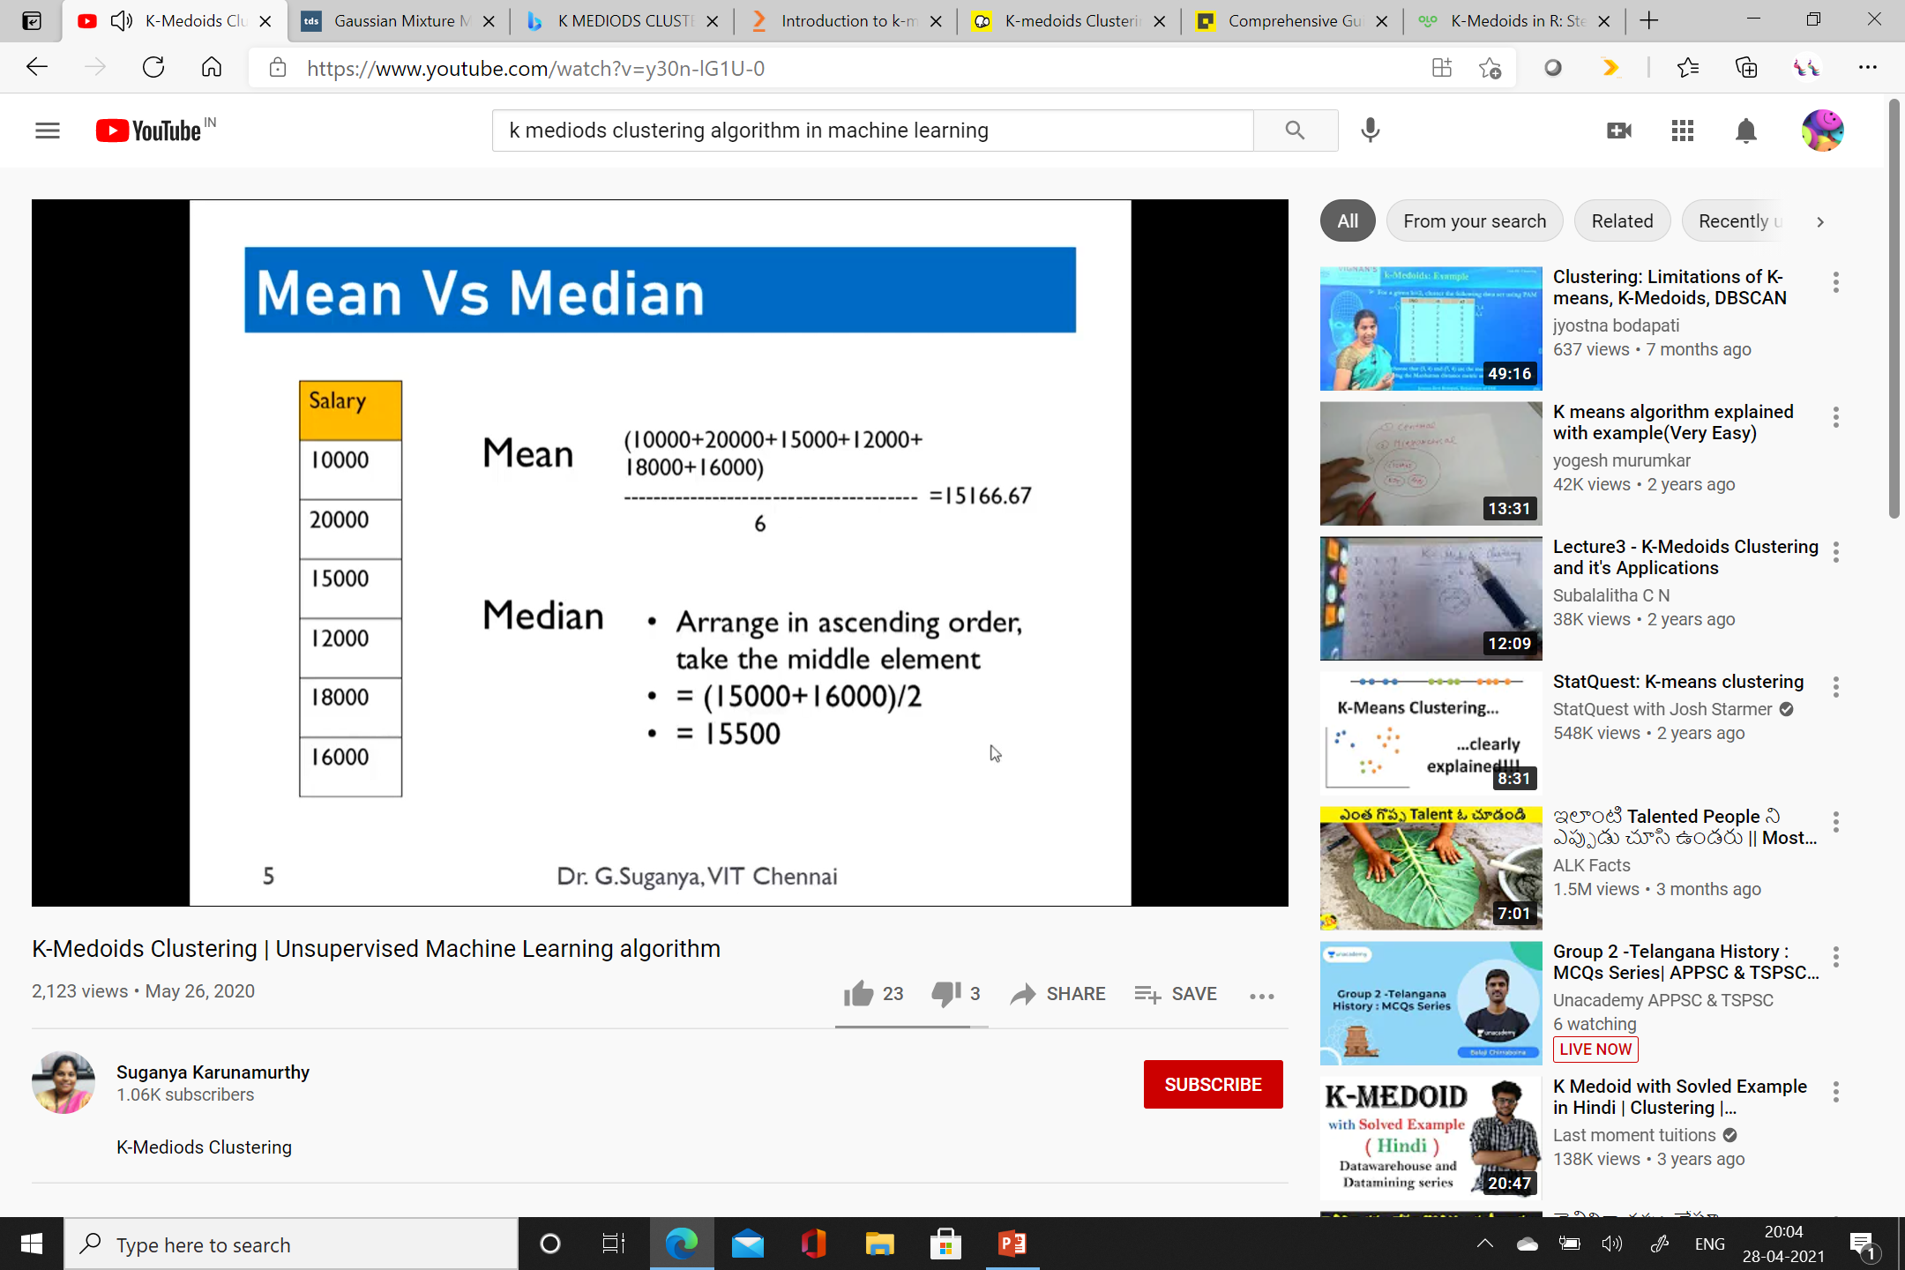

Slide 19
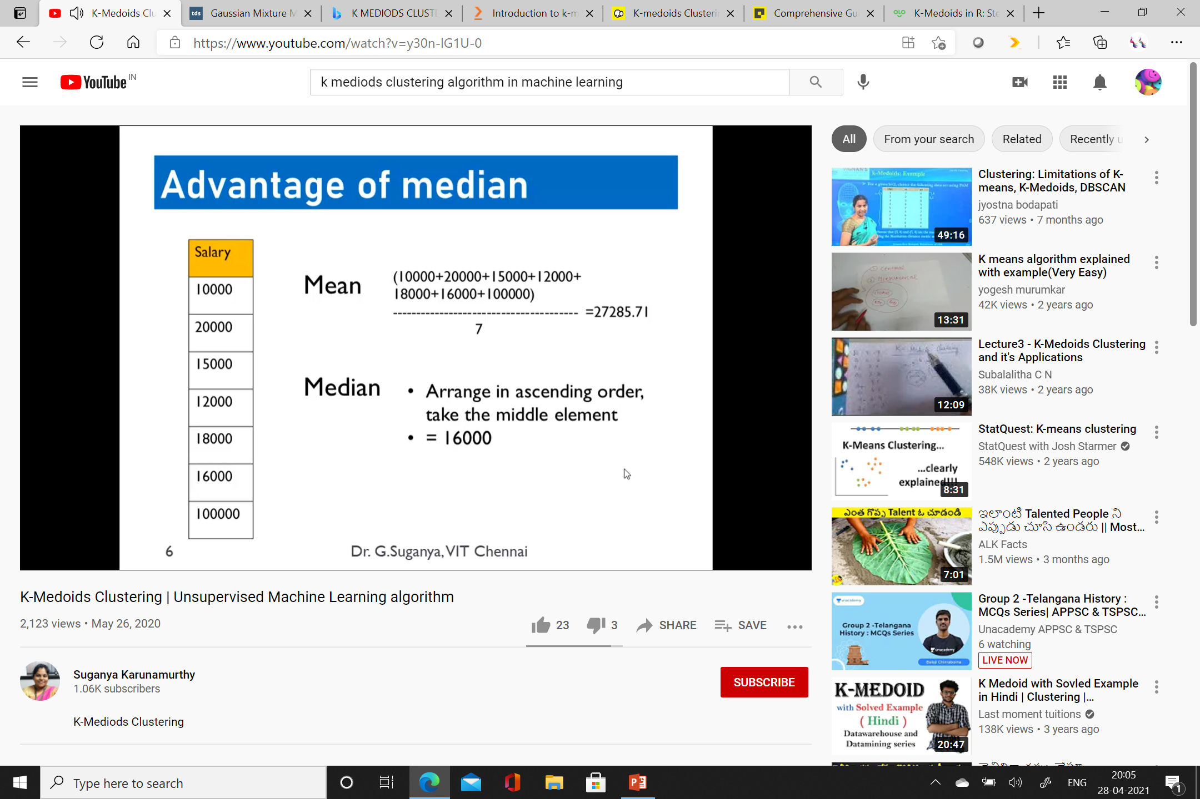

Slide 20
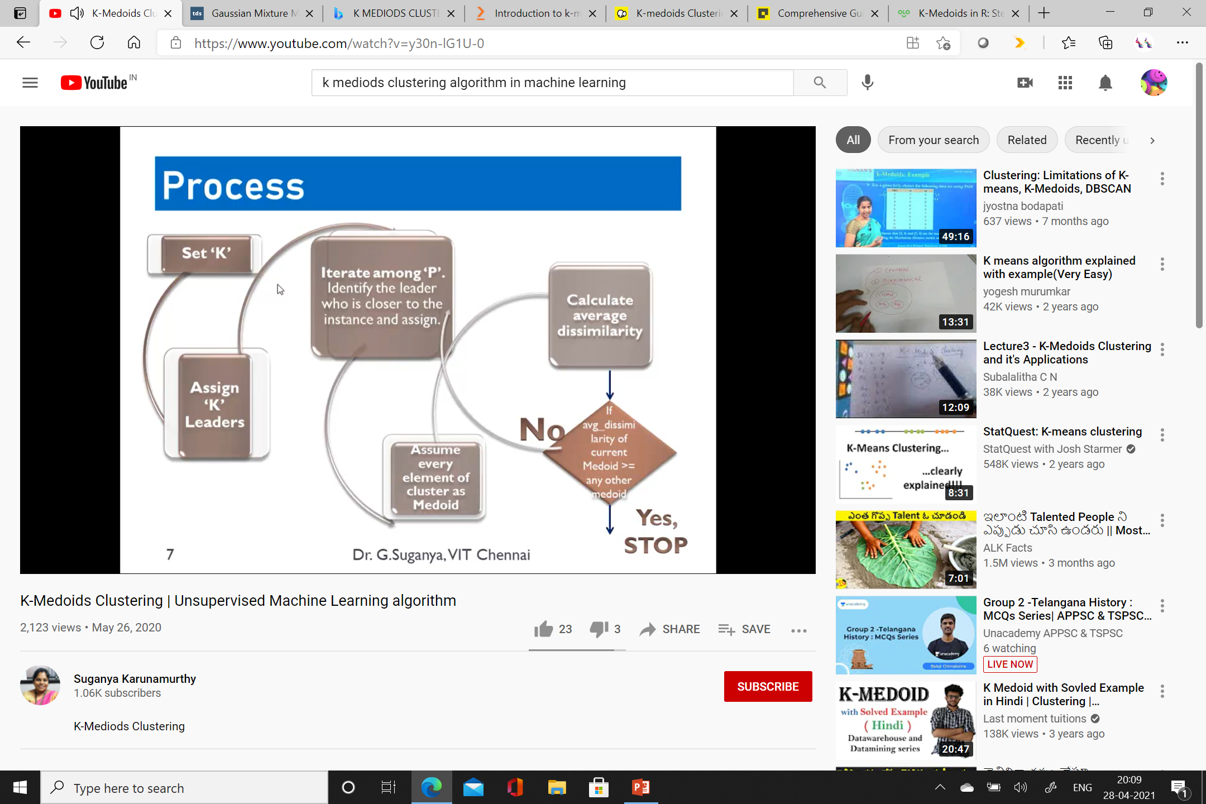

Slide 21
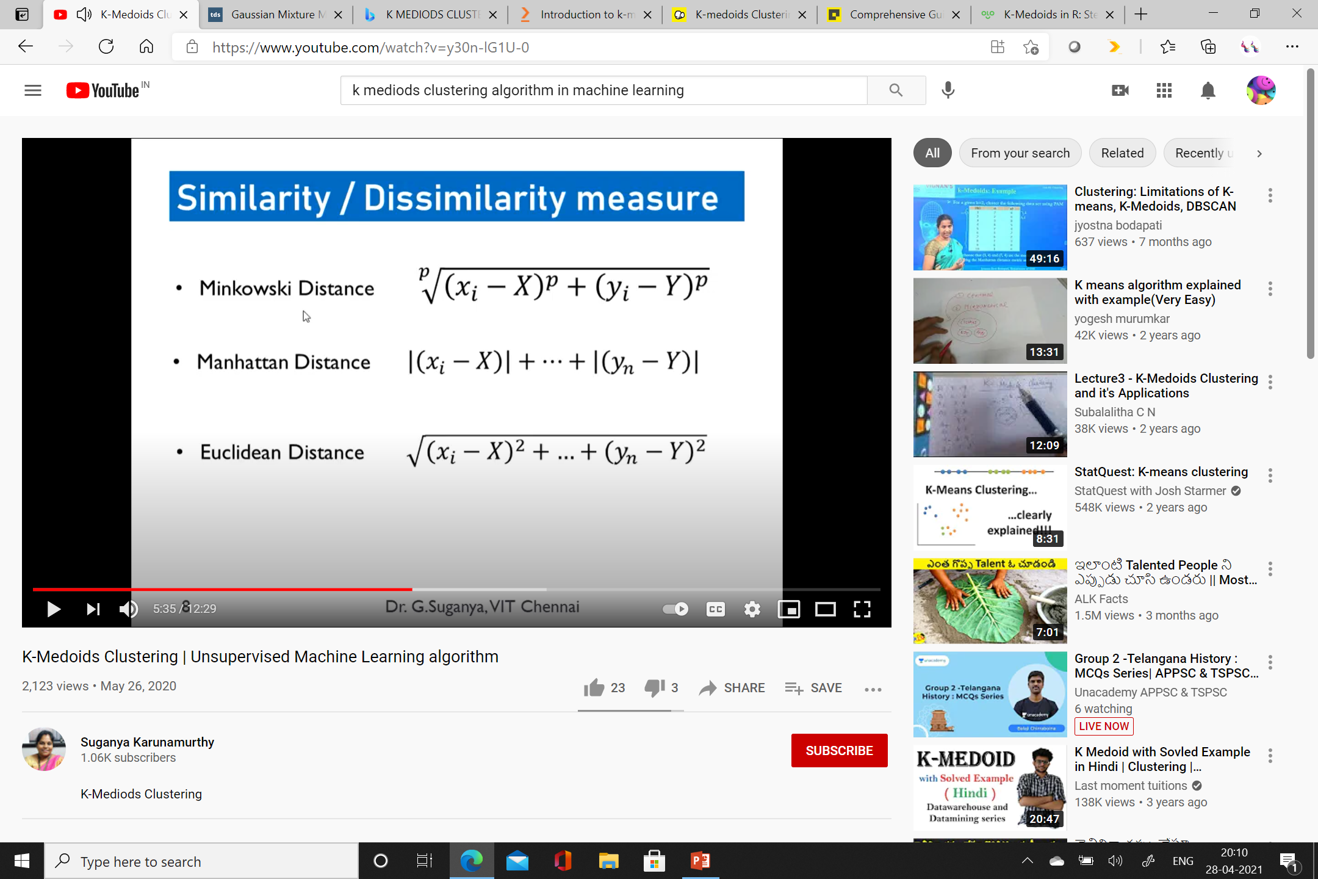

Slide 22
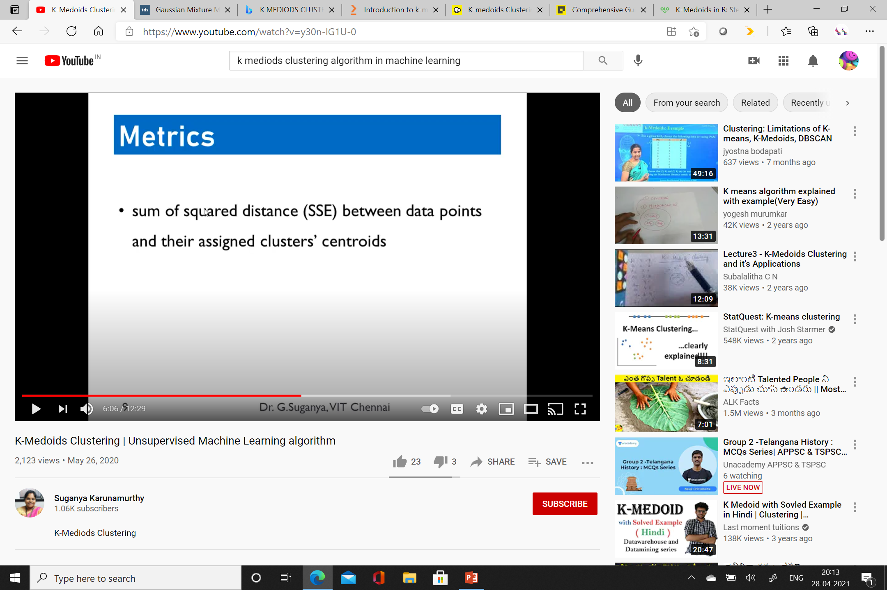

Slide 23
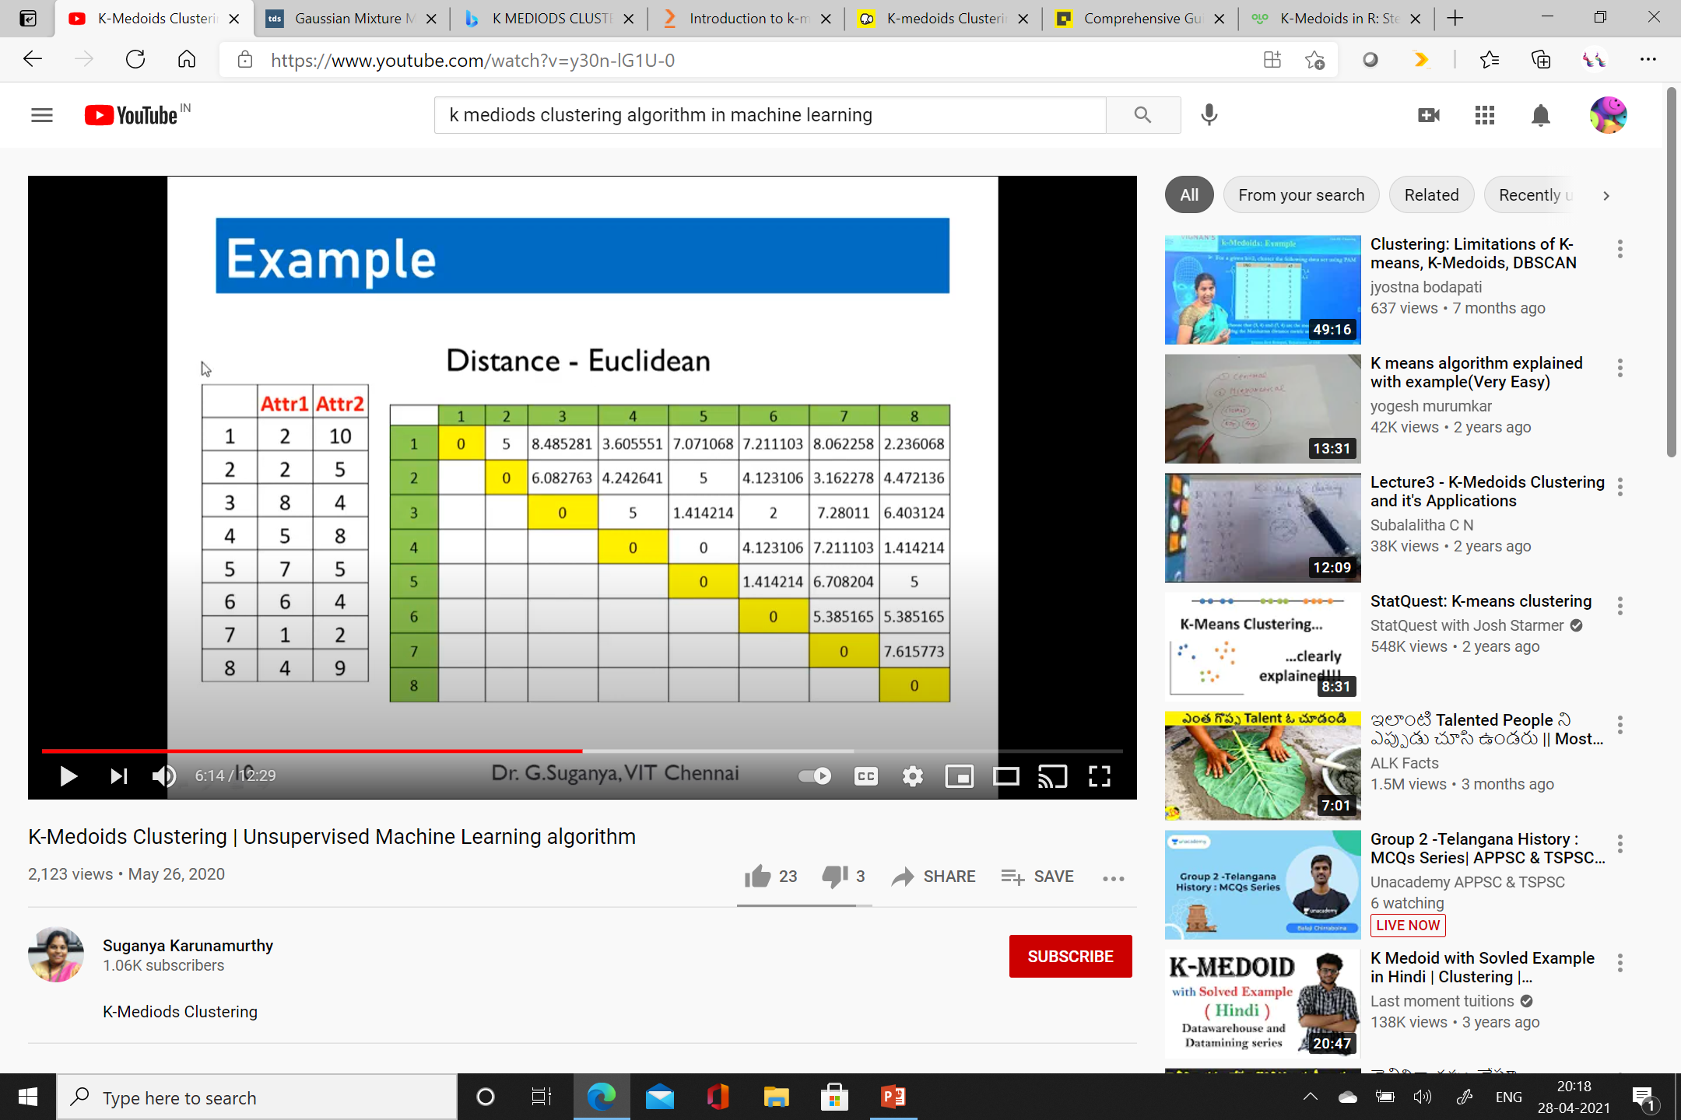

Slide 24
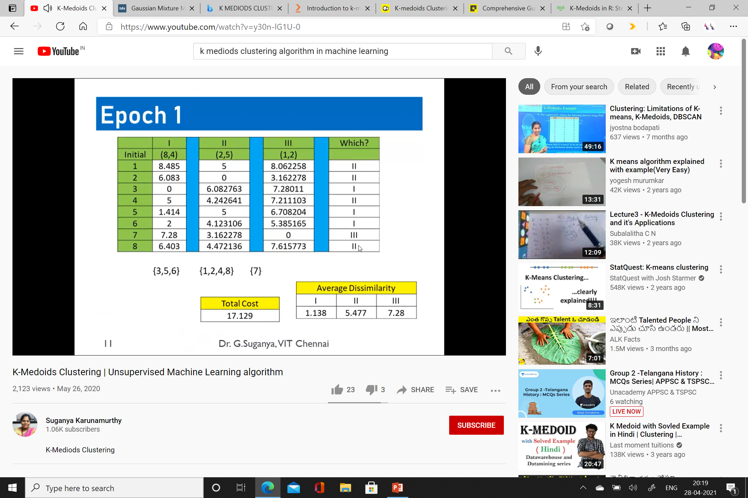
Total Cost
5+0+0+4.242641+1.414+2+0+4.472136 = 17.129

Slide 25
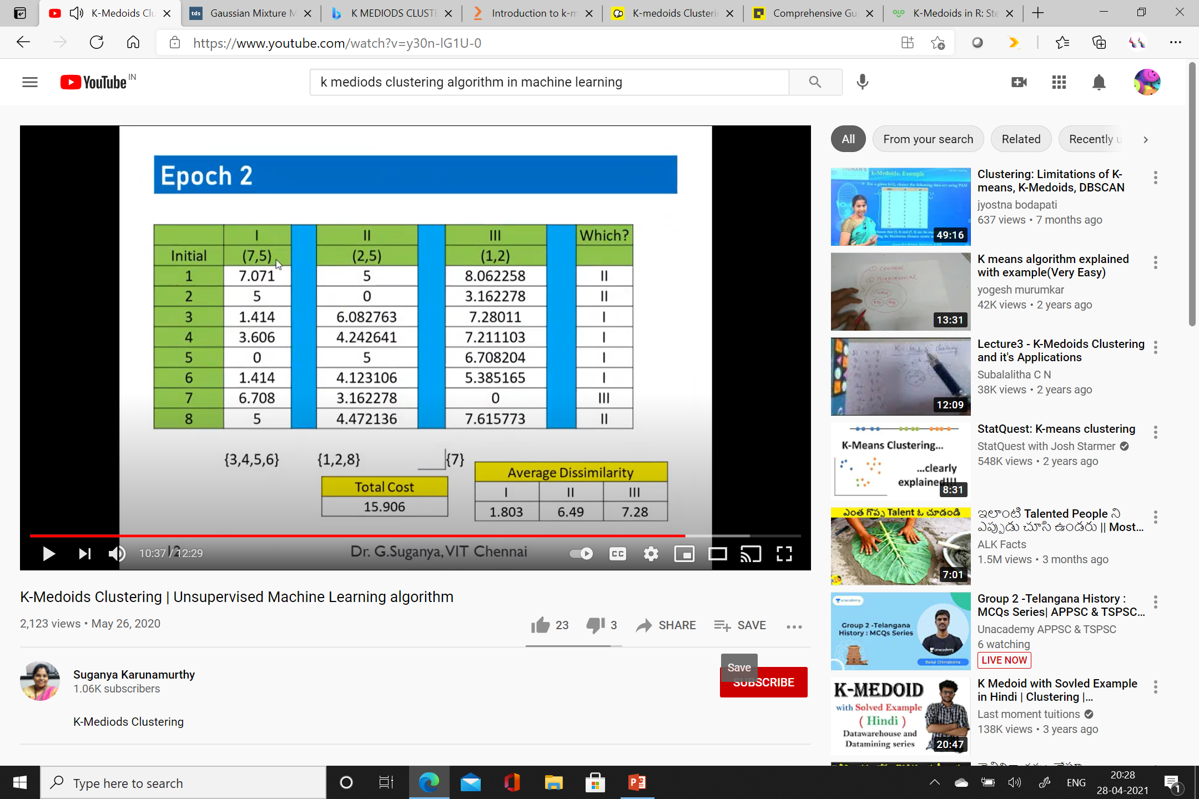

Slide 26
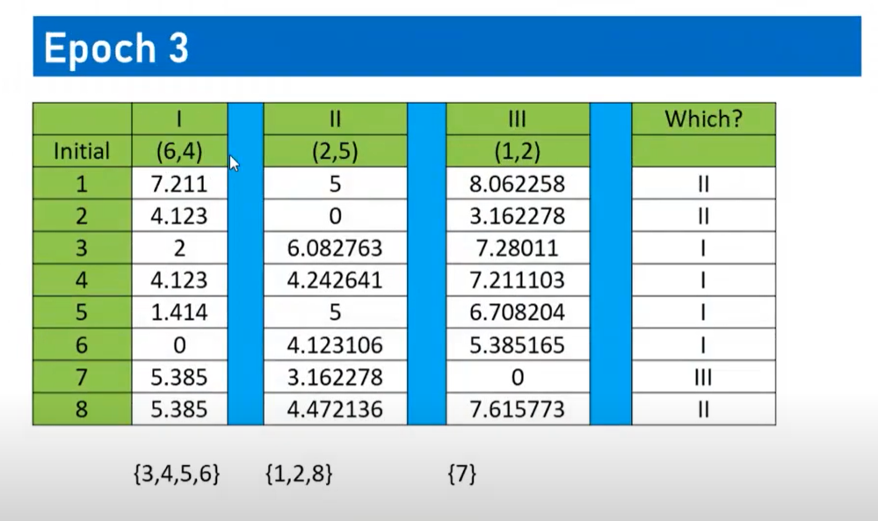

Slide 27
Choose k data points from the scatter plot as starting points for cluster centers.
Calculate their distance from all the points in the scatter plot.
Classify each point into the cluster whose center it is closest to.
Select a new point in each cluster that minimizes the sum of distances of all points in that cluster from itself.
Repeat Step 2 until the centers stop changing.

Slide 28
Gaussian Mixture Model
Gaussian Mixture Models (GMMs) assume that there are a certain number of Gaussian distributions, and each of these distributions represent a cluster.
Hence, a Gaussian Mixture Model tends to group the data points belonging to a single distribution together
Let’s say we have three Gaussian distributions – GD1, GD2, and GD3.
These have a certain mean (μ1, μ2, μ3) and variance (σ1, σ2, σ3) value respectively.
For a given set of data points, our GMM would identify the probability of each data point belonging to each of these distributions.

Slide 29
Gaussian Mixture Models are probabilistic models and use the soft clustering approach for distributing the points in different clusters.
Here, we have three clusters that are denoted by three colors – Blue, Green, and Cyan.
Let’s take the data point highlighted in red.
The probability of this point being a part of the blue cluster is 1, while the probability of it being a part of the green or cyan clusters is 0.

Slide 30
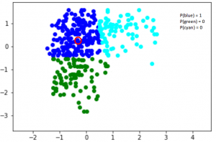

Slide 31
Now, consider another point – somewhere in between the blue and cyan.
The probability that this point is a part of cluster green is 0,
And the probability that this belongs to blue and cyan is 0.2 and 0.8 respectively.

Slide 32
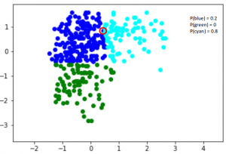

Slide 33
Gaussian Distribution
It has a bell-shaped curve, with the data points symmetrically distributed around the mean value.
The below image has a few Gaussian distributions with a difference in mean (μ) and variance (σ²).

Slide 34
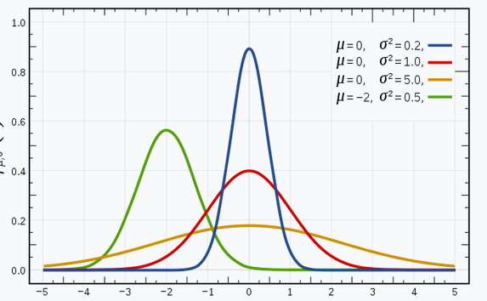

Slide 35

Probability Density Function
But this would only be true for a single variable.
In the case of two variables, instead of a 2D bell-shaped curve

Slide 36
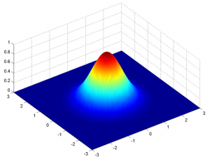

where x is the input vector, μ is the 2D mean vector, and Σ is the 2×2 covariance matrix.
The covariance would now define the shape of this curve.

Slide 37
EM
Expectation-Maximization (EM) is a statistical algorithm for finding the right model parameters. We typically use EM when the data has missing values, or in other words, when the data is incomplete
Expectation-Maximization tries to use the existing data to determine the optimum values for these variables and then finds the model parameters.
Broadly, the Expectation-Maximization algorithm has two steps:
E-step: In this step, the available data is used to estimate (guess) the values of the missing variables
M-step: Based on the estimated values generated in the E-step, the complete data is used to update the parameters

Slide 38
Let’s say we need to assign k number of clusters.
This means that there are k Gaussian distributions, with the mean and covariance values to be μ₁, μ_{2, .. μk} and Σ₁, Σ₂, .. Σk .
Additionally, there is another parameter for the distribution that defines the number of points for the distribution.
Or in other words, the density of the distribution is represented with Π_{i}.
Now, we need to find the values for these parameters to define the Gaussian distributions.
We already decided the number of clusters, and randomly assigned the values for the mean, covariance, and density.
Next, we’ll perform the E-step and the M-step!

Slide 39
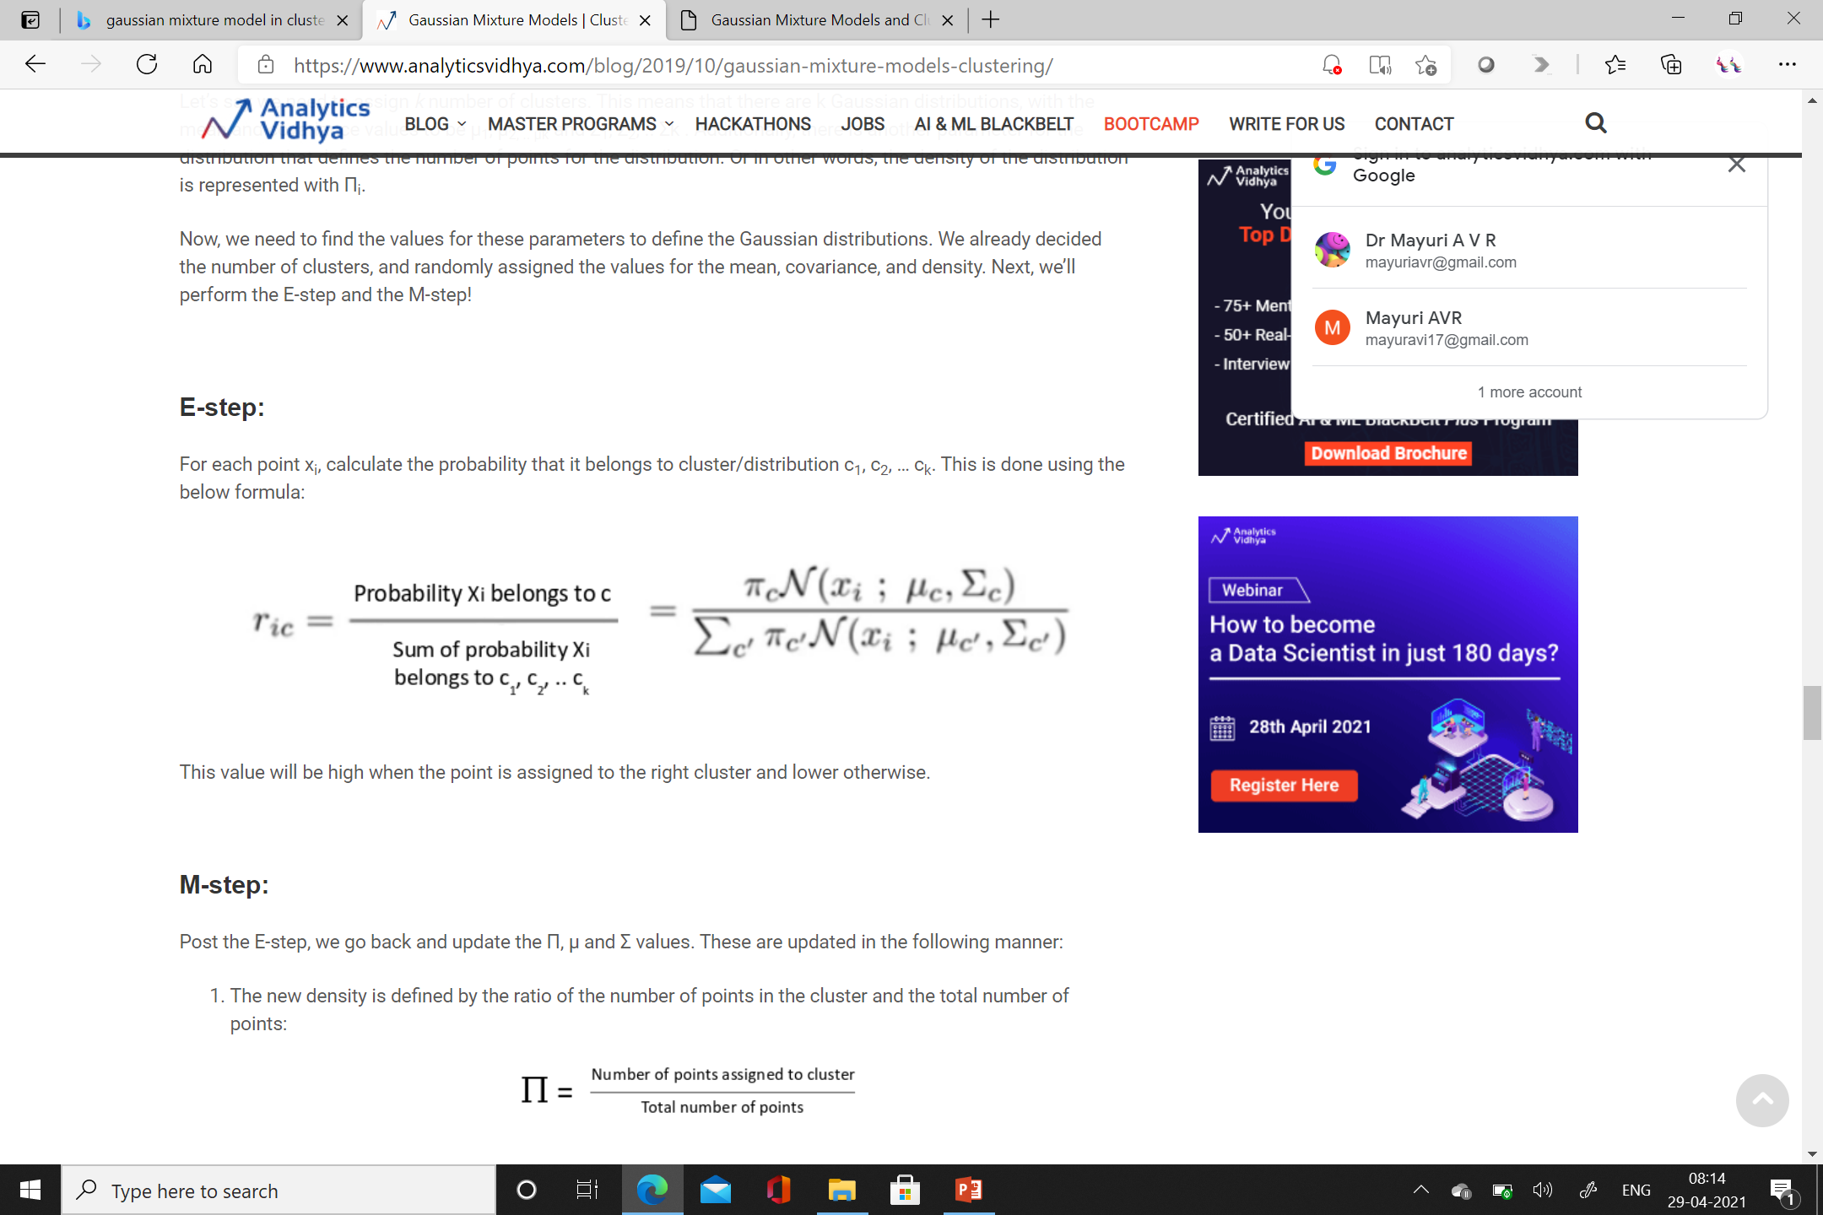

Slide 40
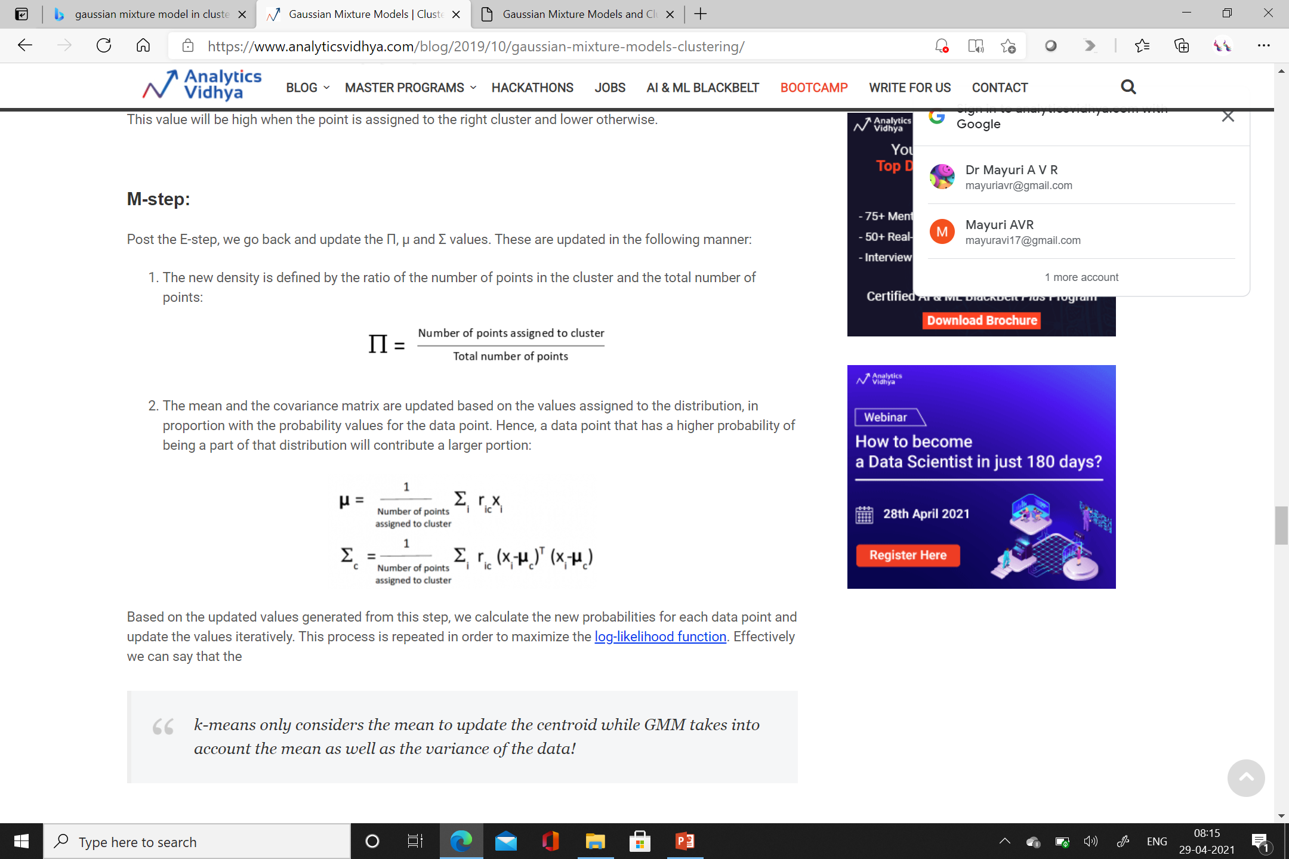

Slide 41
k-means only considers the mean to update the centroid while GMM takes into account the mean as well as the variance of the data!

Slide 42
Machine Learning
Supervised Learning
A supervised learning algorithm learns from labeled training data, helps you to predict outcomes for unforeseen data.
Unsupervised Learning
Unsupervised learning is a machine learning technique, where you do not need to supervise the model.
Instead, you need to allow the model to work on its own to discover information. It mainly deals with the unlabelled data.
Semi supervised Learning
Semi-supervised learning is a learning problem that involves a small number of labeled examples and a large number of unlabeled examples.
Learning problems of this type are challenging as neither supervised nor unsupervised learning algorithms are able to make effective use of the mixtures of labeled and untellable data.

Slide 43
Classification
Supervised Machine Learning algorithm can be broadly classified into Regression and Classification Algorithms.
In Regression algorithms, we have predicted the output for continuous values, but to predict the categorical values, we need Classification algorithms.
Classification Algorithm
The Classification algorithm is a Supervised Learning technique that is used to identify the category of new observations on the basis of training data.
In classification algorithm, a discrete output function(y) is mapped to input variable(x).
y=f(x), where y = categorical output

Slide 44
Types of classification
The algorithm which implements the classification on a dataset is known as a classifier.
Binary Classifier: If the classification problem has only two possible outcomes, then it is called as Binary Classifier. Examples: YES or NO, MALE or FEMALE, SPAM or NOT SPAM, CAT or DOG, etc.
Multi-class Classifier: If a classification problem has more than two outcomes, then it is called as Multi-class Classifier. Example: Classifications of types of crops, Classification of types of music.

Slide 45
Learners
In the classification problems, there are two types of learners:
Lazy Learners: Lazy Learner firstly stores the training dataset and wait until it receives the test dataset.
In Lazy learner case, classification is done on the basis of the most related data stored in the training dataset.
It takes less time in training but more time for predictions.
Example: K-NN algorithm, Case-based reasoning
Eager Learners: Eager Learners develop a classification model based on a training dataset before receiving a test dataset.
Opposite to Lazy learners, Eager learners take less time in training and more time in prediction.
Example: Decision Trees, Naïve Bayes, ANN.

Slide 46
Types of Classification Algorithms:
Classification Algorithms can be further divided into the Mainly two category:
Linear Models
Logistic Regression
Support Vector Machines
Non-linear Models
K-Nearest Neighbours
Kernel SVM
Naïve Bayes
Decision Tree Classification
Random Forest Classification

Slide 47
K-Nearest Neighbour
Based on Supervised Learning technique.
Assumes the similarity between the new case/data and available cases and put the new case into the category that is most similar to the available categories.
K-NN algorithm stores all the available data and classifies a new data point based on the similarity.
This means when new data appears then it can be easily classified into a well suite category by using K- NN algorithm.
K-NN is a non-parametric algorithm, which means it does not make any assumption on underlying data.
It is also called a lazy learner algorithm because it does not learn from the training set immediately instead it stores the dataset and at the time of classification, it performs an action on the dataset.
KNN algorithm at the training phase just stores the dataset and when it gets new data, then it classifies that data into a category that is much similar to the new data.

Slide 48
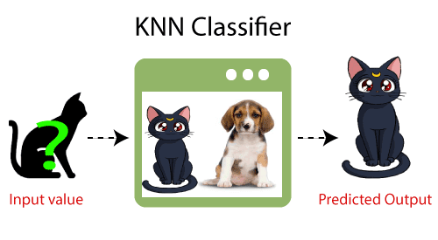
KNN Classifier

Slide 49
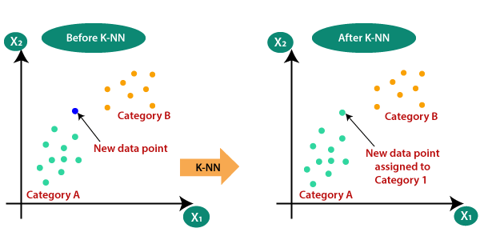
Why K-NN

Slide 50
Step-1: Select the number K of the neighbors
Step-2: Calculate the Euclidean distance of K number of neighbors
Step-3: Take the K nearest neighbors as per the calculated Euclidean distance.
Step-4: Among these k neighbors, count the number of the data points in each category.
Step-5: Assign the new data points to that category for which the number of the neighbor is maximum.
Step-6: Our model is ready.

Slide 51
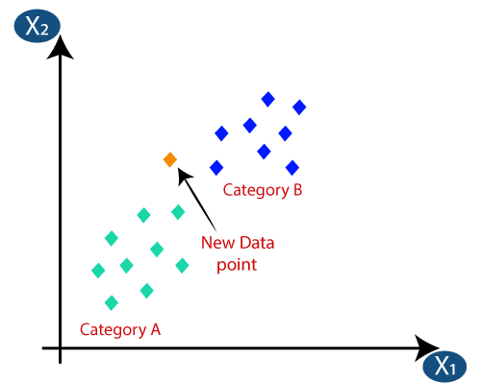

Slide 52
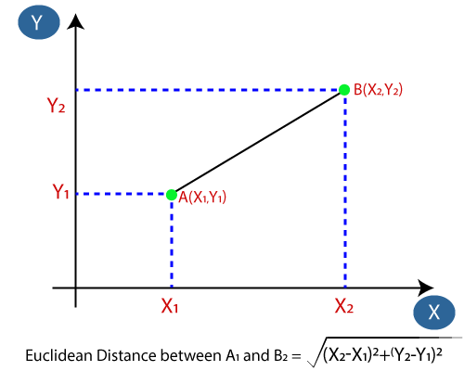

Slide 53
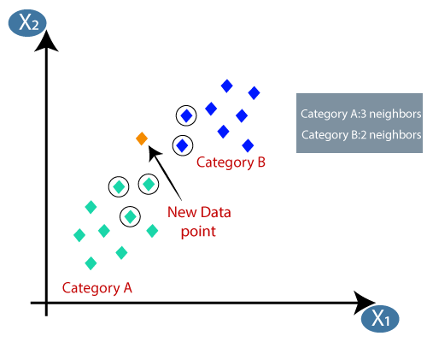

Slide 54
Select K value
There is no particular way to determine the best value for "K", so we need to try some values to find the best out of them.
The most preferred value for K is 5.
A very low value for K such as K=1 or K=2, can be noisy and lead to the effects of outliers in the model.
Large values for K are good, but it may find some difficulties.

Slide 55
Advantages of KNN Algorithm:
It is simple to implement.
It is robust to the noisy training data
It can be more effective if the training data is large.
Disadvantages of KNN Algorithm:
Always needs to determine the value of K which may be complex some time.
The computation cost is high because of calculating the distance between the data points for all the training samples.

Slide 56
Naïve Bayes Classifier
Naïve Bayes algorithm is a supervised learning algorithm,
Based on Bayes theorem and used for solving classification problems.
It is mainly used in text classification that includes a high-dimensional training dataset.
Naïve Bayes Classifier helps in building the fast machine learning models that can make quick predictions.
It is a probabilistic classifier, which means it predicts on the basis of the probability of an object.

Slide 57
The Naïve Bayes algorithm is comprised of two words Naïve and Bayes, Which can be described as:
Naïve: It is called Naïve because it assumes that the occurrence of a certain feature is independent of the occurrence of other features.
Hence each feature individually contributes to identify without depending on each other.
Bayes: It is called Bayes because it depends on the principle of Bayes' Theorem.

Slide 58

Bayes' theorem is used to determine the probability of a hypothesis with prior knowledge. It depends on the conditional probability.

Slide 59
P(A|B) is Posterior probability: Probability of hypothesis A on the observed event B.
P(B|A) is Likelihood probability: Probability of the evidence given that the probability of a hypothesis is true.
P(A) is Prior Probability: Probability of hypothesis before observing the evidence.
P(B) is Marginal Probability: Probability of Evidence.

Slide 60
Suppose we have a dataset of weather conditions and corresponding target variable "Play".
So using this dataset we need to decide that whether we should play or not on a particular day according to the weather conditions.
Convert the given dataset into frequency tables.
Generate Likelihood table by finding the probabilities of given features.
Now, use Bayes theorem to calculate the posterior probability.

Slide 61
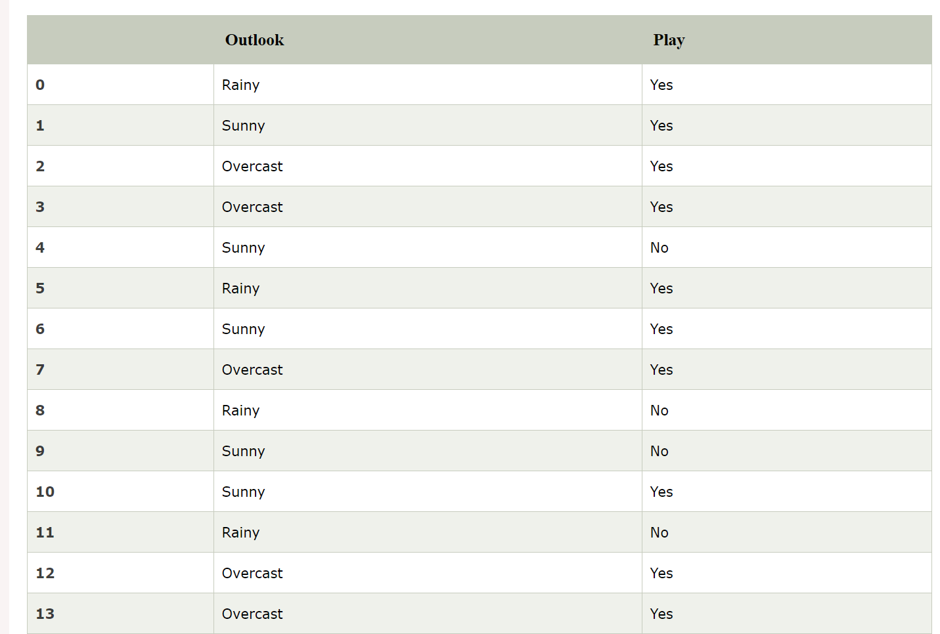
Problem: If the weather is sunny, then the Player should play or not?

Slide 62
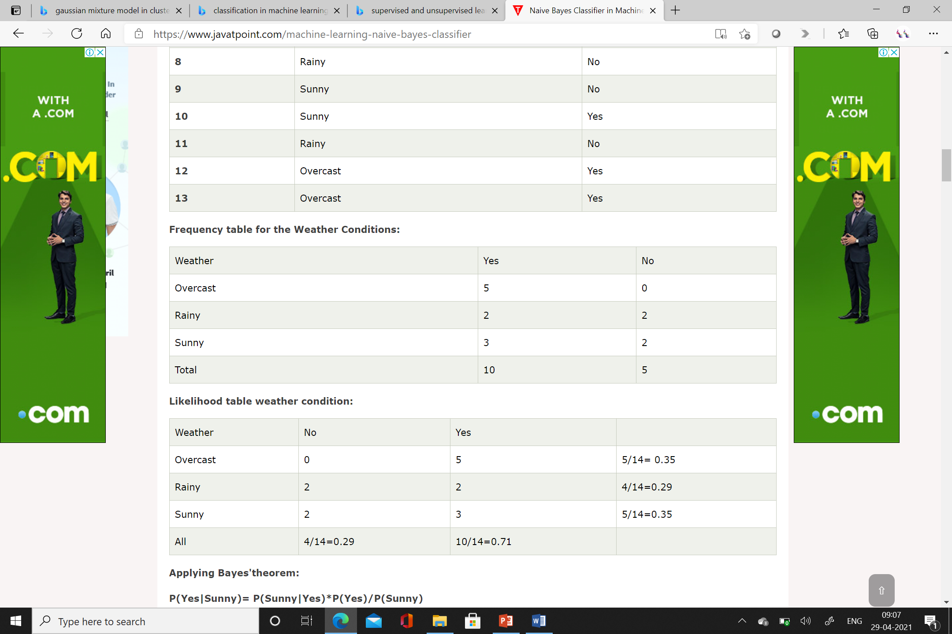

Slide 63
Applying Bayes'theorem:
P(Yes|Sunny)= P(Sunny|Yes)*P(Yes)/P(Sunny)
P(Sunny|Yes)= 3/10= 0.3
P(Sunny)= 0.35
P(Yes)=0.71
So P(Yes|Sunny) = 0.3*0.71/0.35= 0.60
P(No|Sunny)= P(Sunny|No)*P(No)/P(Sunny)
P(Sunny|NO)= 2/4=0.5
P(No)= 0.29
P(Sunny)= 0.35
So P(No|Sunny)= 0.5*0.29/0.35 = 0.41
So as we can see from the above calculation that P(Yes|Sunny)>P(No|Sunny)
Hence on a Sunny day, Player can play the game.

Slide 64
Advantages of Naïve Bayes Classifier:
Naïve Bayes is one of the fast and easy ML algorithms to predict a class of datasets.
It can be used for Binary as well as Multi-class Classifications.
It performs well in Multi-class predictions as compared to the other Algorithms.
It is the most popular choice for text classification problems.
Disadvantages of Naïve Bayes Classifier:
Naive Bayes assumes that all features are independent or unrelated, so it cannot learn the relationship between features.

Slide 65
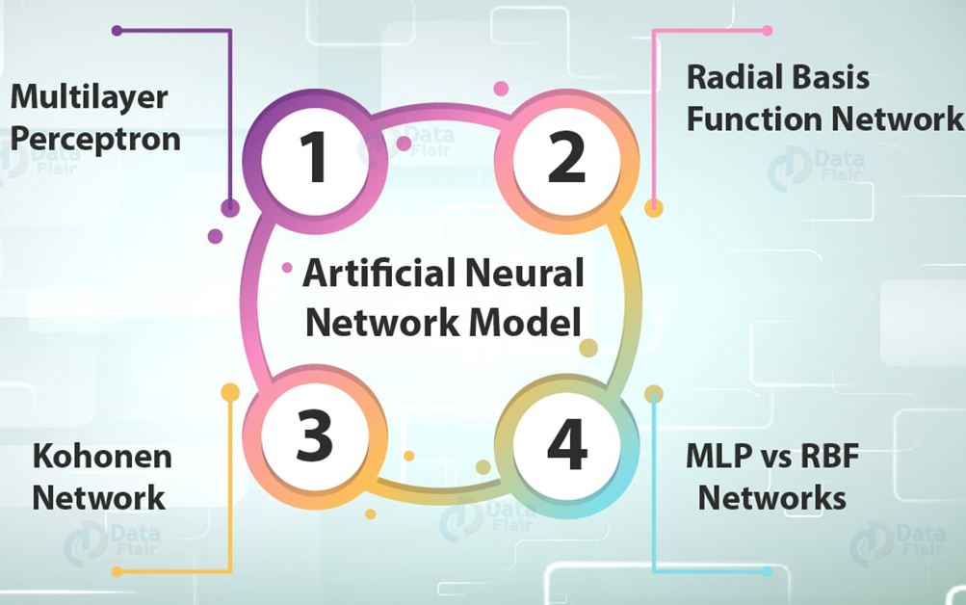
Artificial neural Network model

Slide 66
Multilayer Perceptron – It is a feedforward artificial neural network model. It maps sets of input data onto a set of appropriate outputs.
Radial Basis Function Network – A radial basis function network is an artificial neural network. It uses radial basis functions as activation functions.
Both of the above are being supervised learning networks used with 1 or more dependent variables at the output.

Slide 67
Multilayer Perceptron
A multilayer perceptron is a feedforward artificial neural network model.
It maps sets of input data onto a set of appropriate outputs.
In feed-forward neural networks, the movement is only possible in the forward direction.
An MLP consists of many layers of nodes in a directed graph, with each layer connected to the next one.
Each neuron is a linear equation like linear regression as shown in the following equation

Slide 68
Radial Basis Function Network
A Radial Basis Function (RBF) network is a supervised learning network
RBF network works with only one hidden layer.
It accomplishes this by calculating the value of each unit in the hidden layer for an observation.
It uses the distance in space between this observation and the center of the unit.
Instead of the sum of the weighted values of the units of the preceding level.
The centers of the hidden layer of an RBF network are not adjusted at each iteration during learning.
In RBF network, hidden neurons share the space and are virtually independent of each other.
This makes for faster convergence of RBF networks in the learning phase

Slide 69
Dimensionality Reduction

